Slide 2
Power BI
Aesthetic app

Slide 3
STEP1: Clean data

Slide 4
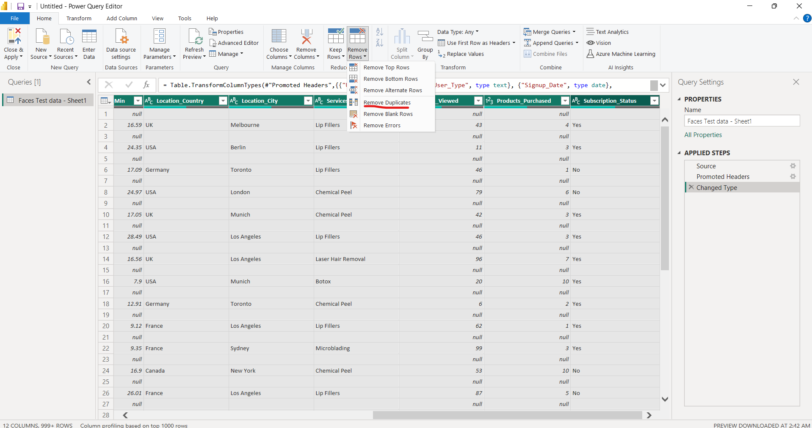
1. Remove Duplicates

Slide 5
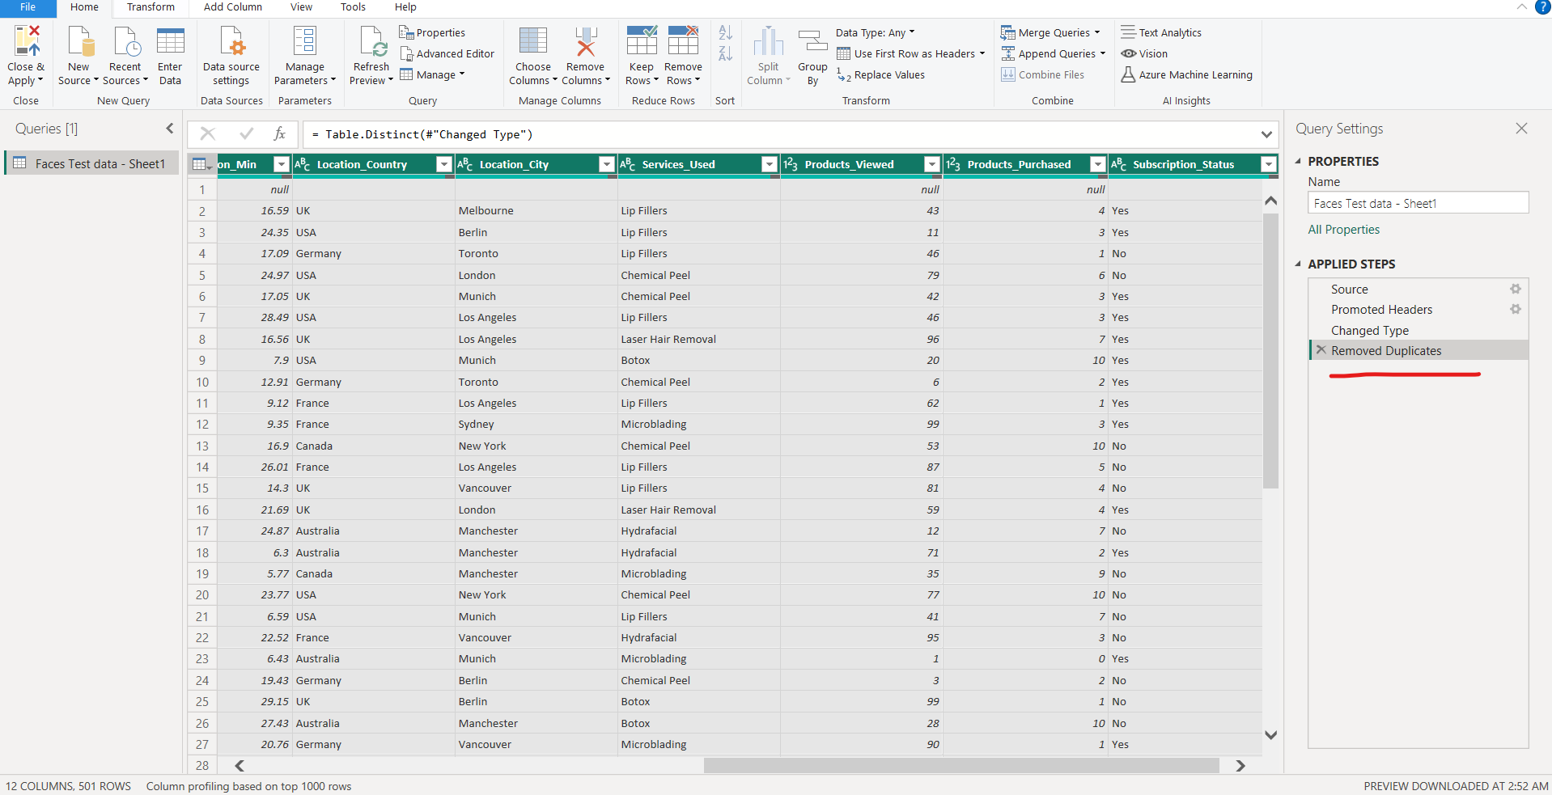
Duplicates Removed

Slide 6
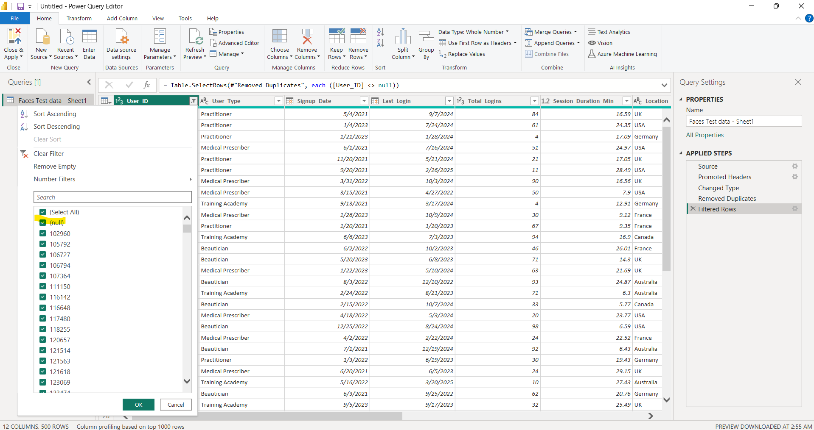
2. Identify and remove null values

Slide 7
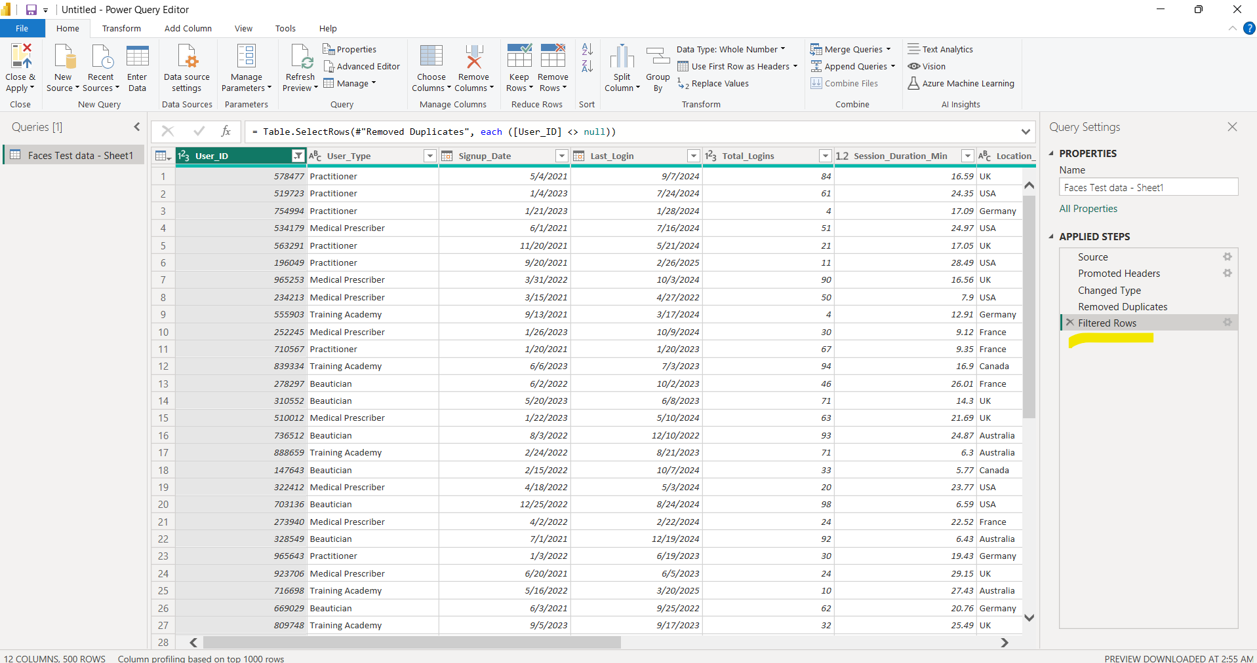
Null values removed

Slide 8
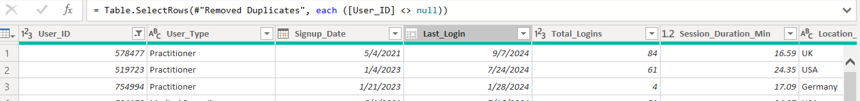
3. Standardize column names for consistency.

Slide 9
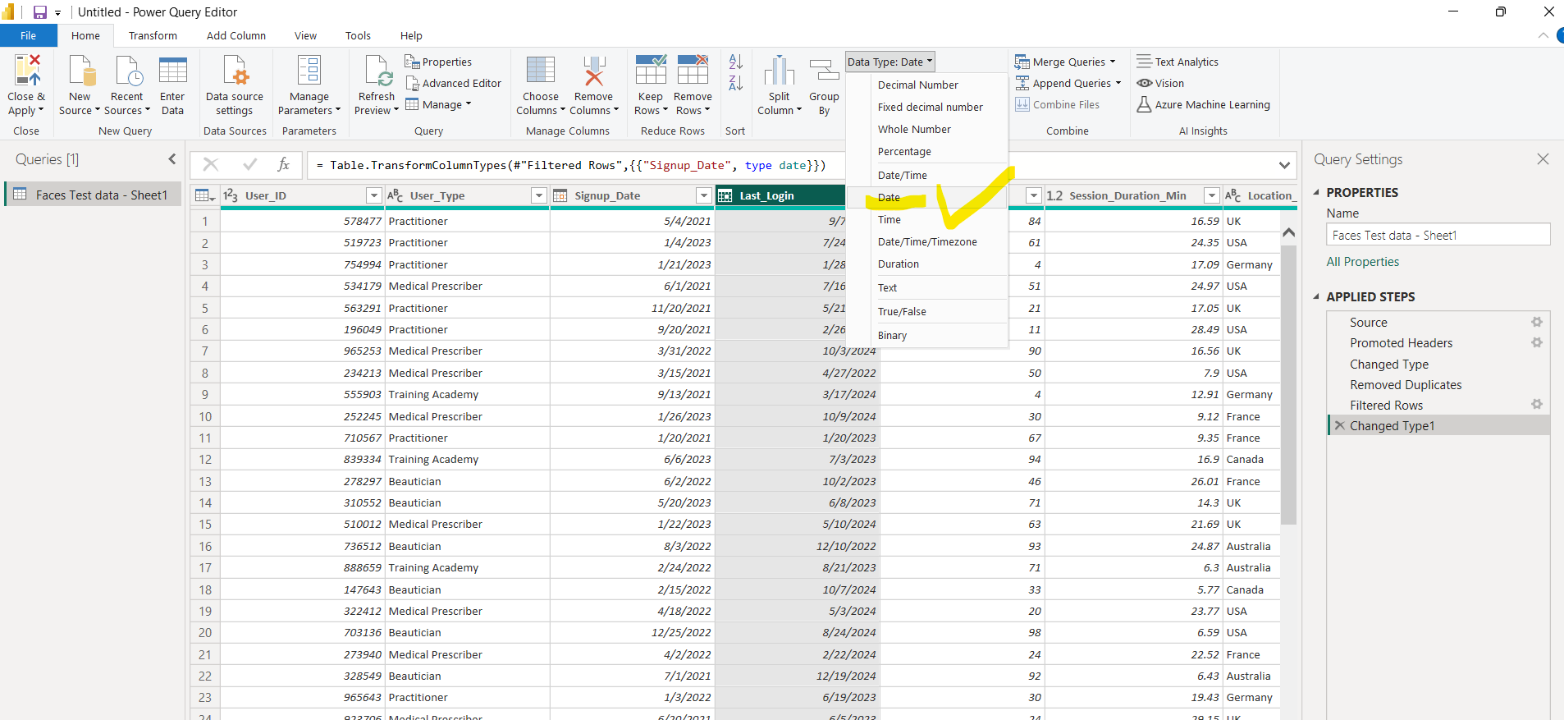
4. Convert Data Types Ensure date fields are in DateTime format.

Slide 10
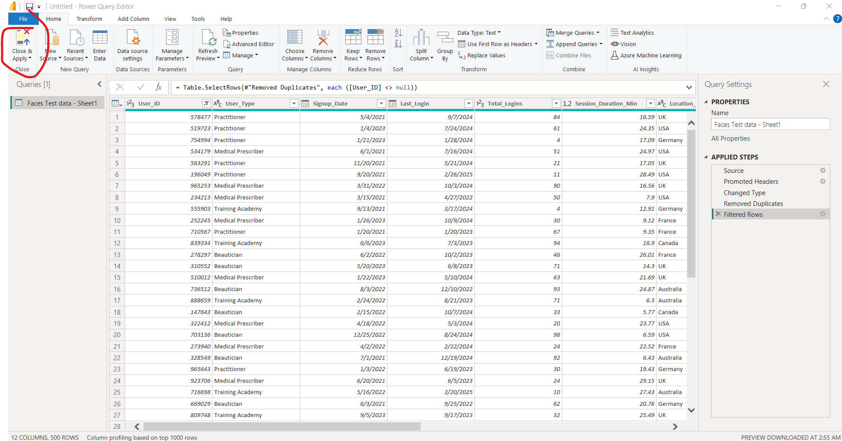
5. Export Clean data-> Close and apply to the cleaning changes u have made to the data

Slide 11
Clean data would be loaded to power BI

Slide 12
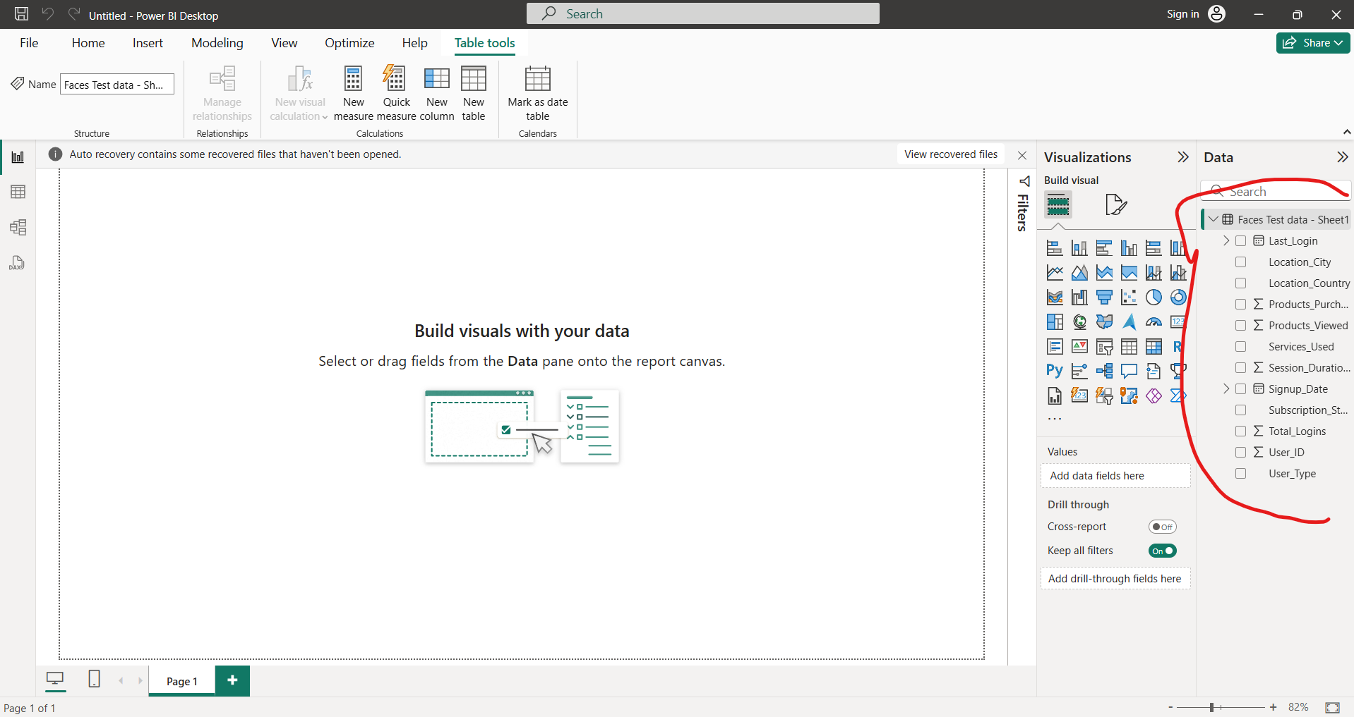
Clean Data loaded

